Slide 1
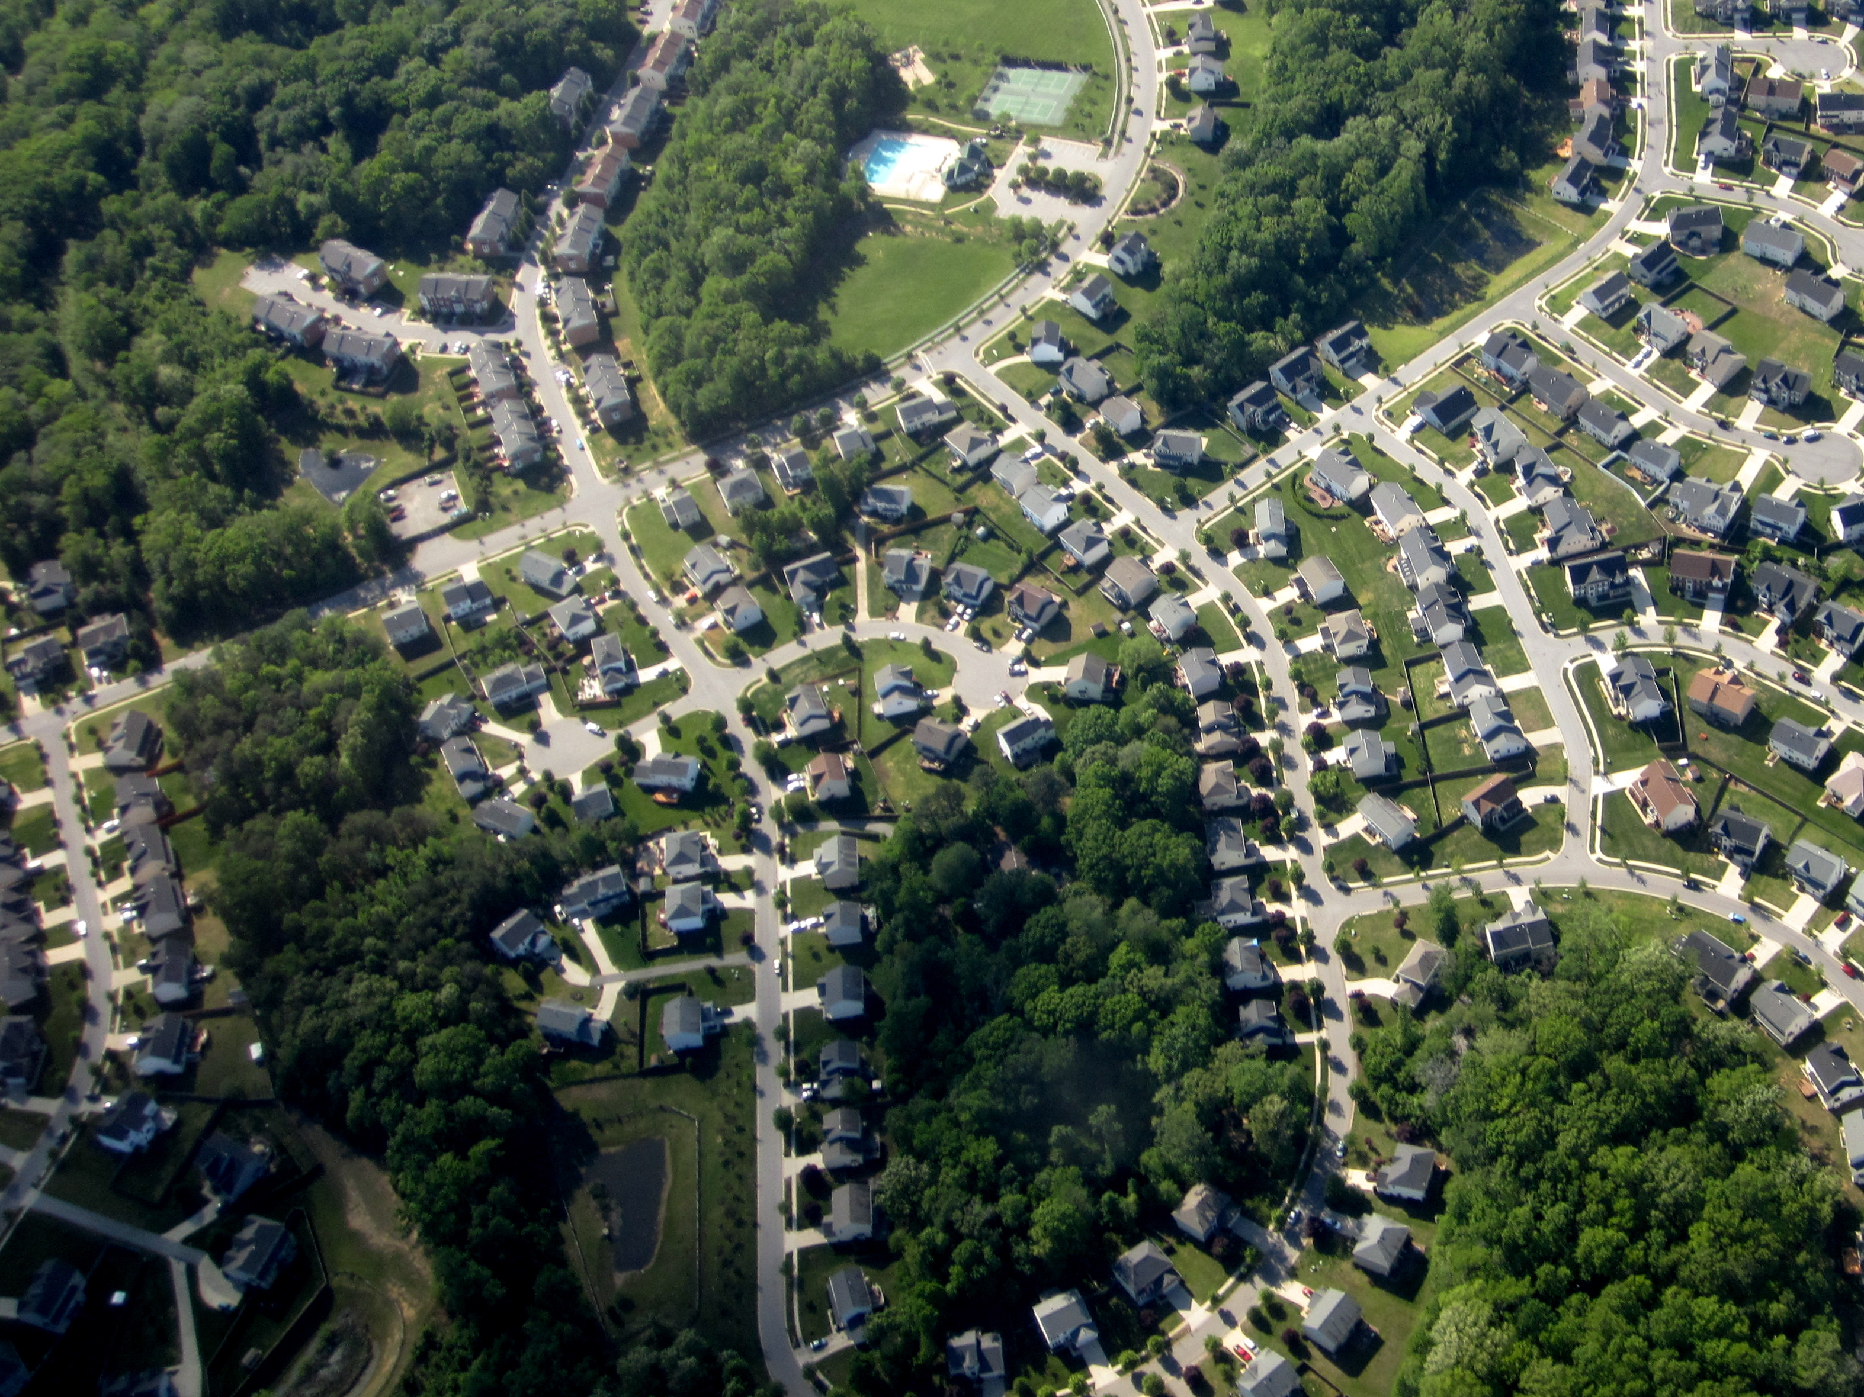
The Problem
As humans develop land for housing and industry, natural habitats shrink and become more isolated. This is called habitat fragmentation.

Slide 2
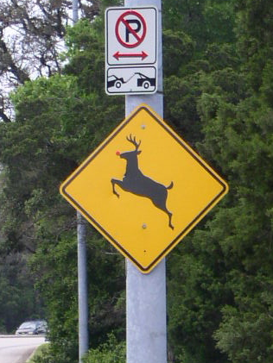
Consequences
1
Smaller patches of habitat make it harder for native animals to find food, shelter, and mates.
Non-native invasive species thrive in these altered environments and outcompete native species.
Some native species, like deer, become too abundant and prevent native plants from regenerating.
2
3
Over time, these changes alter the make up of our remaining forests and wetlands. And that makes it even harder for our native plants and animals to survive.

Slide 3
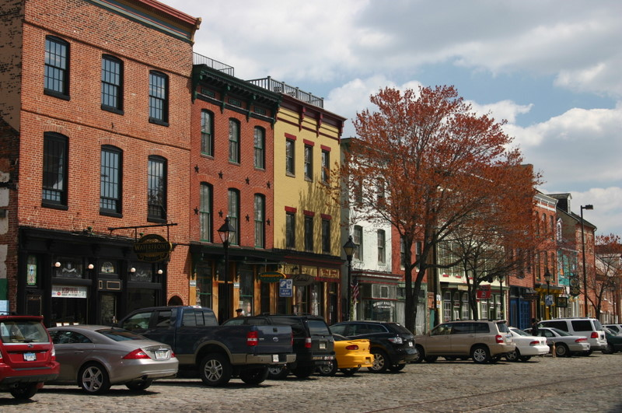
1
What Can You Do about It?
Reduce Urban Sprawl
Living in cities is one of the best ways to help preserve native habitats!
This limits the amount of land and resources we use. It also reduces pollution by limiting the need to drive.

Slide 4
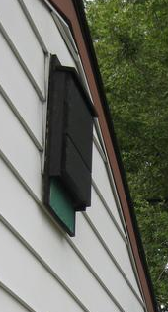
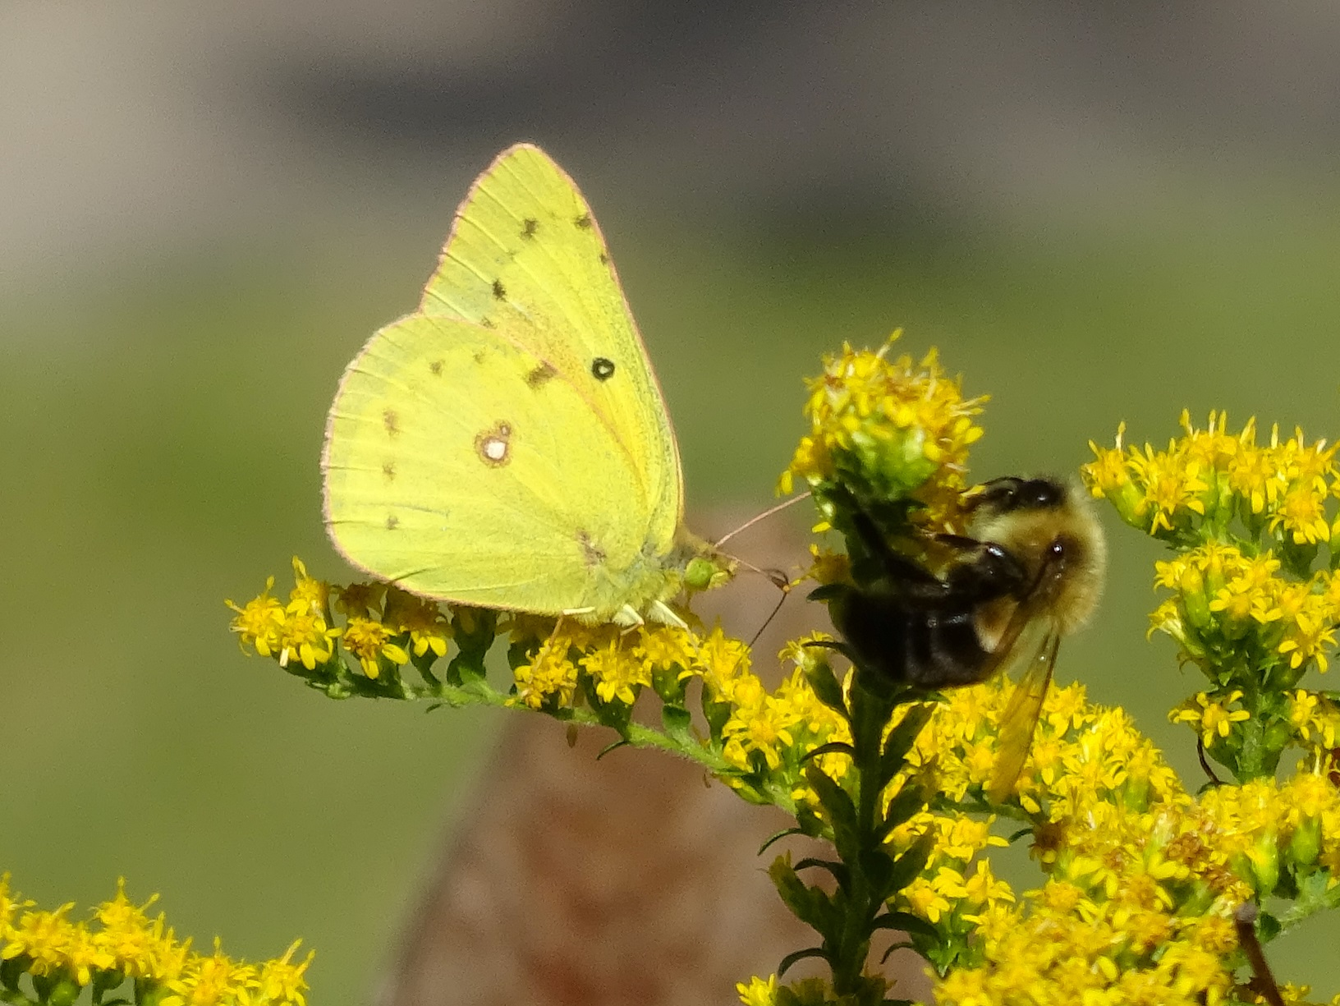
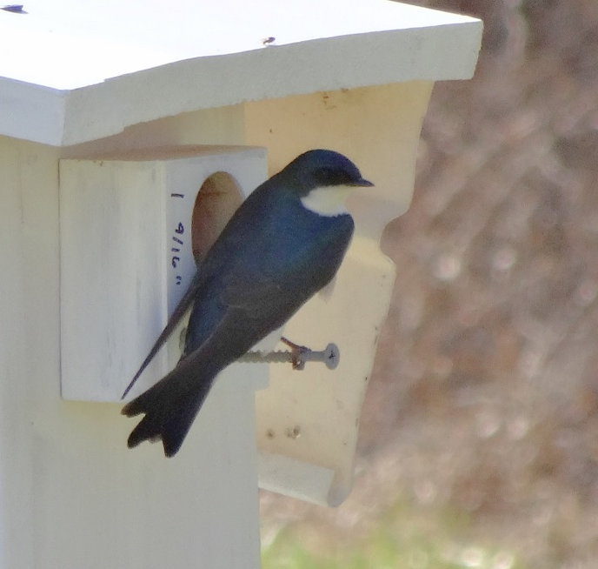
2
What Can You Do about It?
Create Habitat
Grow native plants in your yard to provide food and shelter for wildlife. If you have a big lawn, plant some of it with native trees!
Learn about the benefits of putting up bird houses and bat houses. Birds and bats help to control mosquitoes and other insect pests.
Bat house

Slide 5
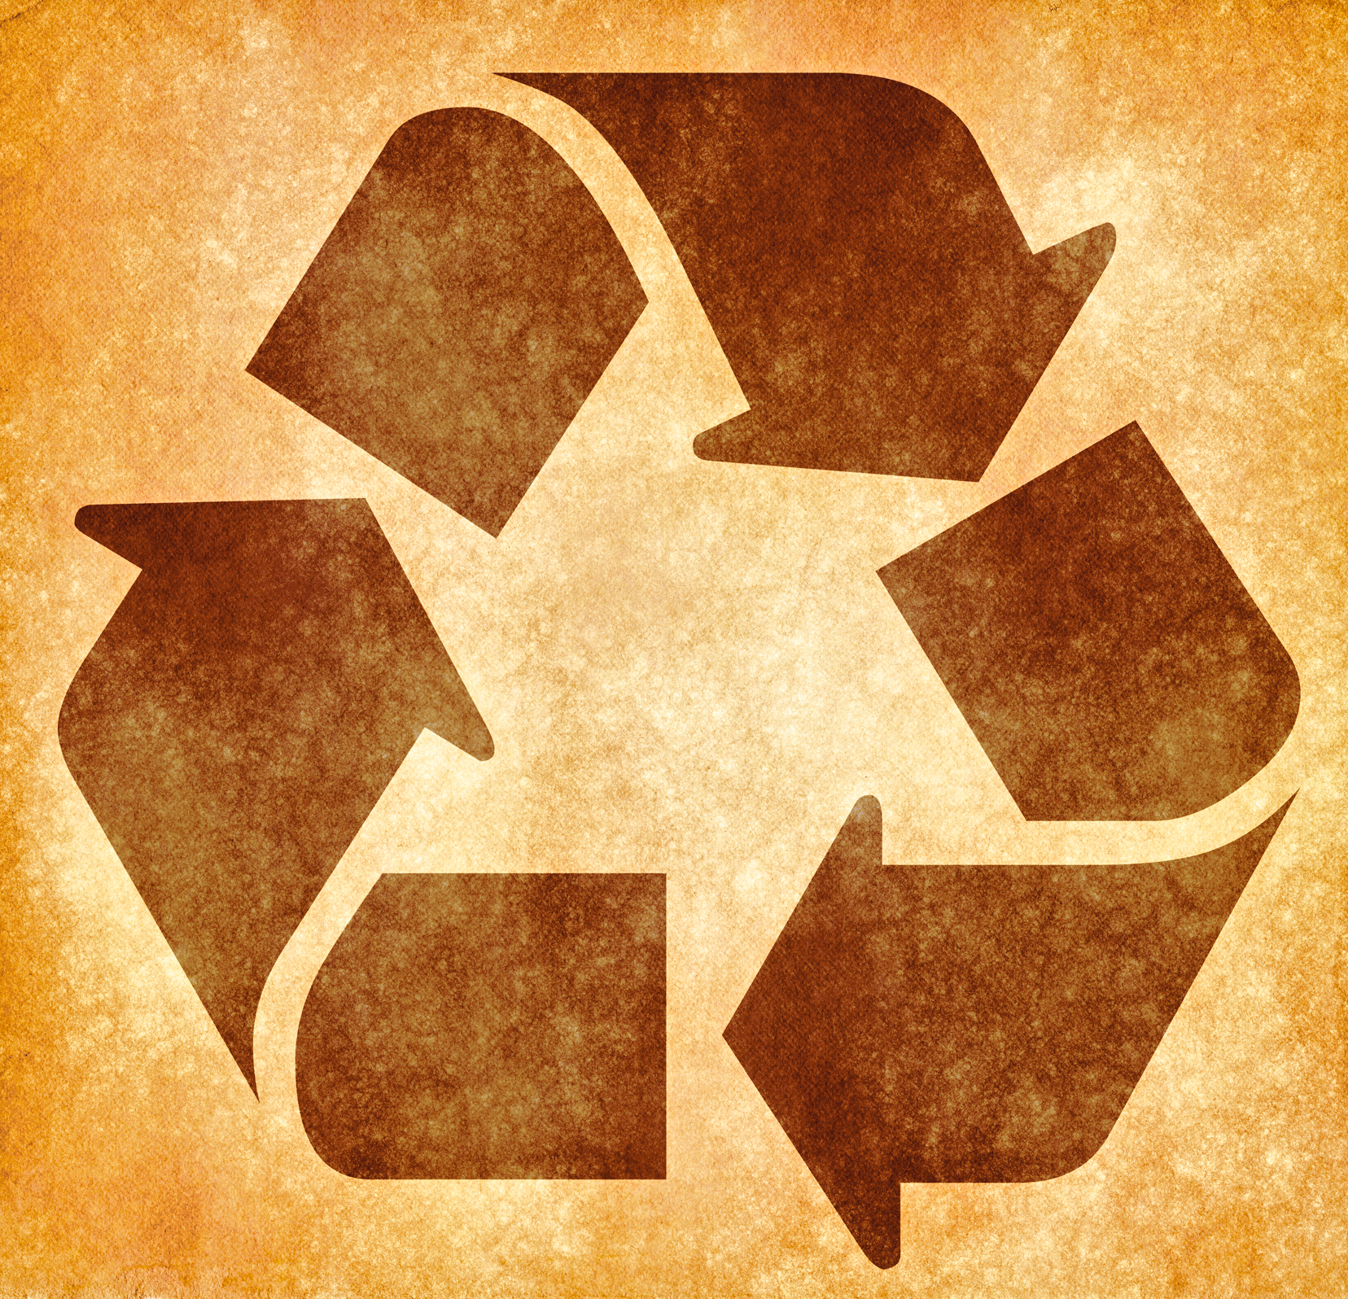
3
What Can You Do about It?
Conserve Resources
Be more careful about what you use and throw away!
Buying less and recycling more means you’ll use fewer resources that require land. This will help preserve habitat—not only in Maryland, but throughout the world!

Slide 6
Credits
Photos used under Creative Commons licenses:
https://creativecommons.org/licenses/by-sa/2.0/legalcode
"Community Planning” by La Citta Vita via flickr.com (cropped)
https://creativecommons.org/licenses/by-nc-nd/2.0/legalcode
“Deer Crossing” by Julián via flickr.com (cropped)
“Bat House” by anneheathen flickr.com (cropped)
https://creativecommons.org/licenses/by/3.0/legalcode
“Recycling Grunge Sign” by Nicolas Raymond via flickr.com (cropped), available at: http://freestock.ca/signs_symbols_g43-recycling_grunge_sign__sepia_p1709.html
“Clouded Sulphur and Bee” courtesy Martha Johnston
“Tree Swallow Perched” courtesy Martha Johnston

